Slide 1

Online Store

Slide 2
Technologies Used:
HTML
Basic Tags
Links
Tables
Pre
Forms
CSS
Hover
Color
Background
Padding

Slide 3
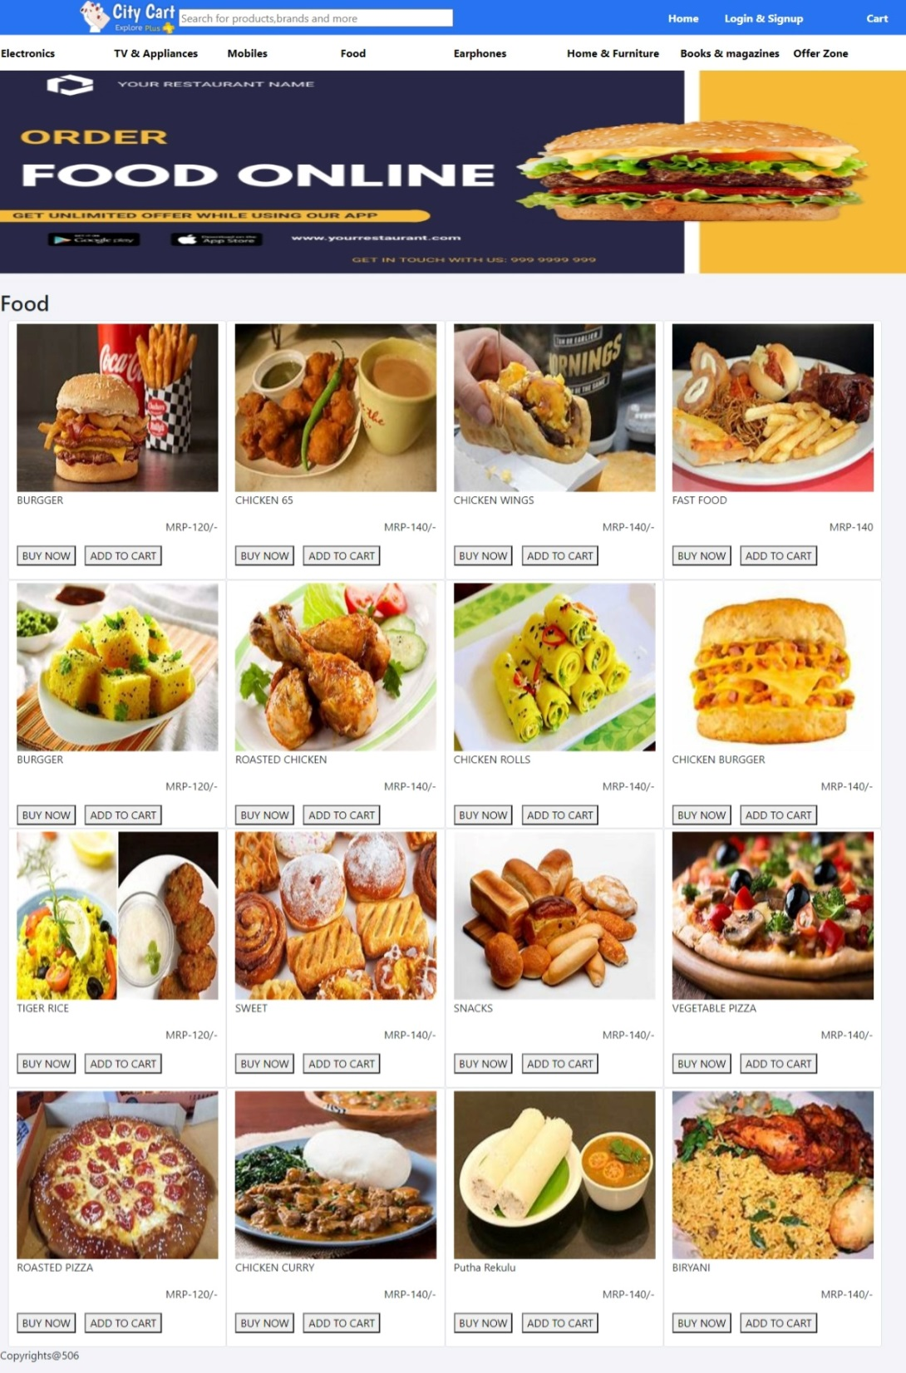

Slide 4
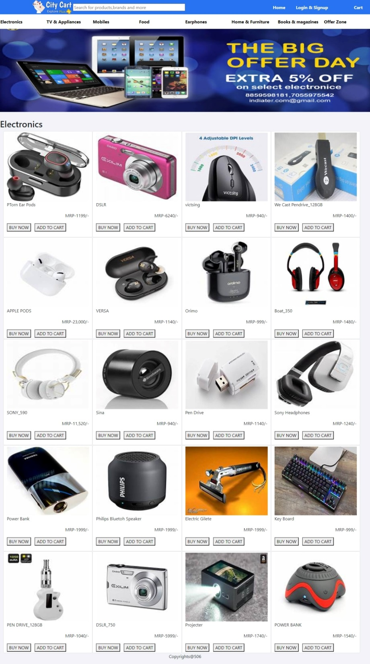

Slide 5


